Slide 1
Task 2
3/10/2023

Slide 2
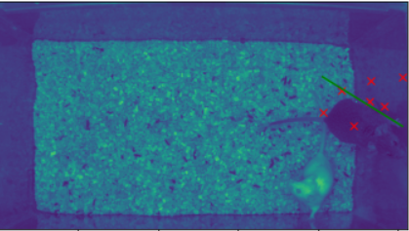
Data preparation
Problem with tail_end feature in top dataset
There is no tail end label in top dataset so I put 0.
Bounding box
Max and min values for x, y points
Height
Width
Bounding box center
Min X, Max Y
Max X, Min Y

Slide 3
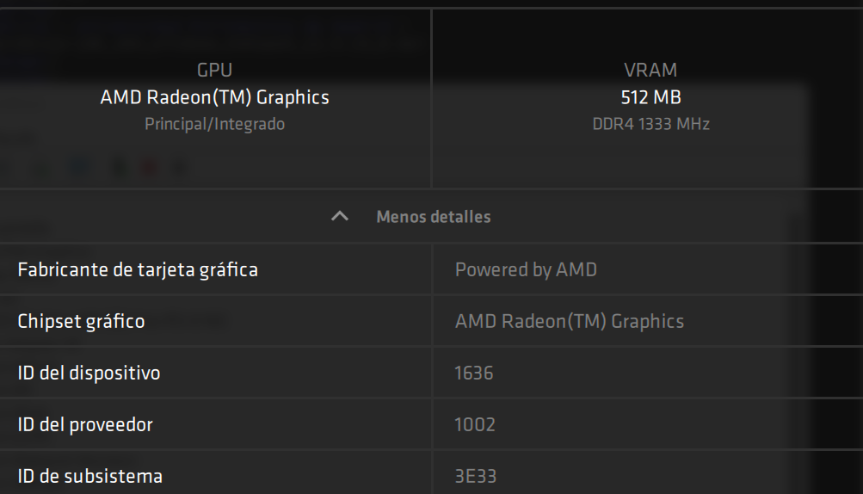
Google Colab
No GPUs or AMD Ryzen graphic
Used annotated data provided

Slide 4
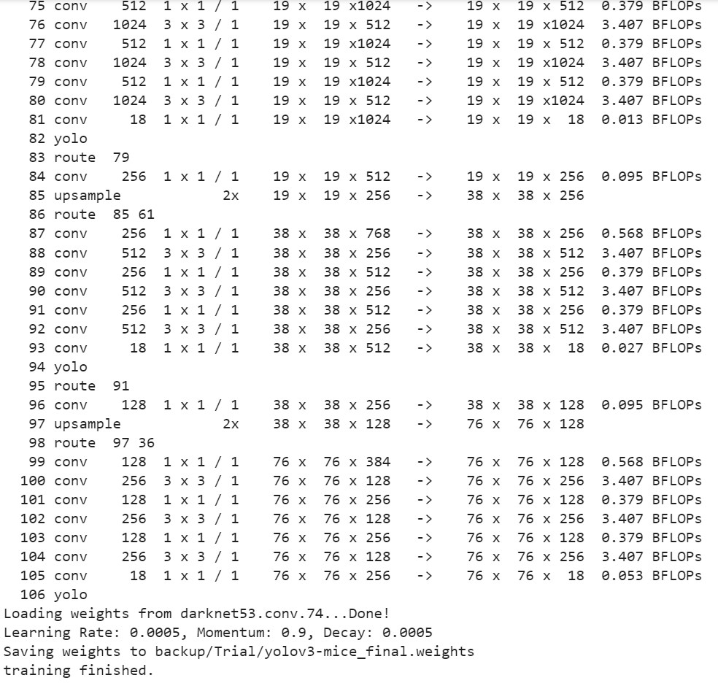
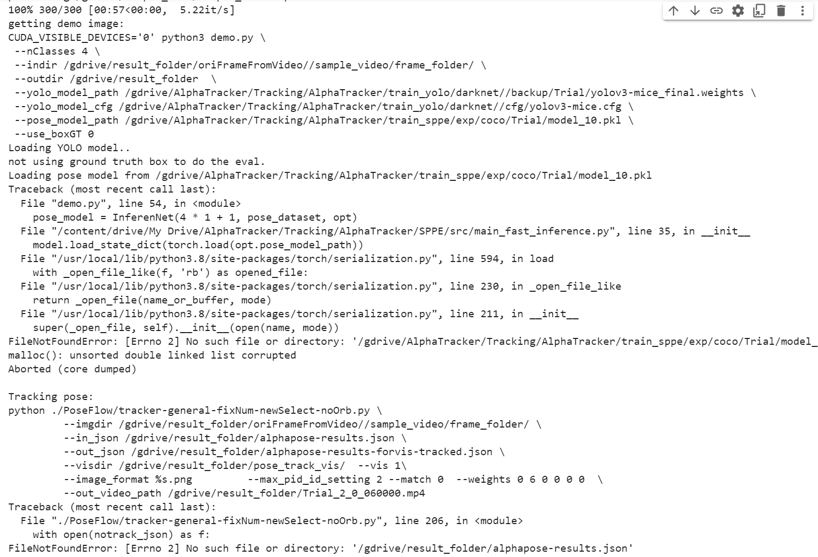
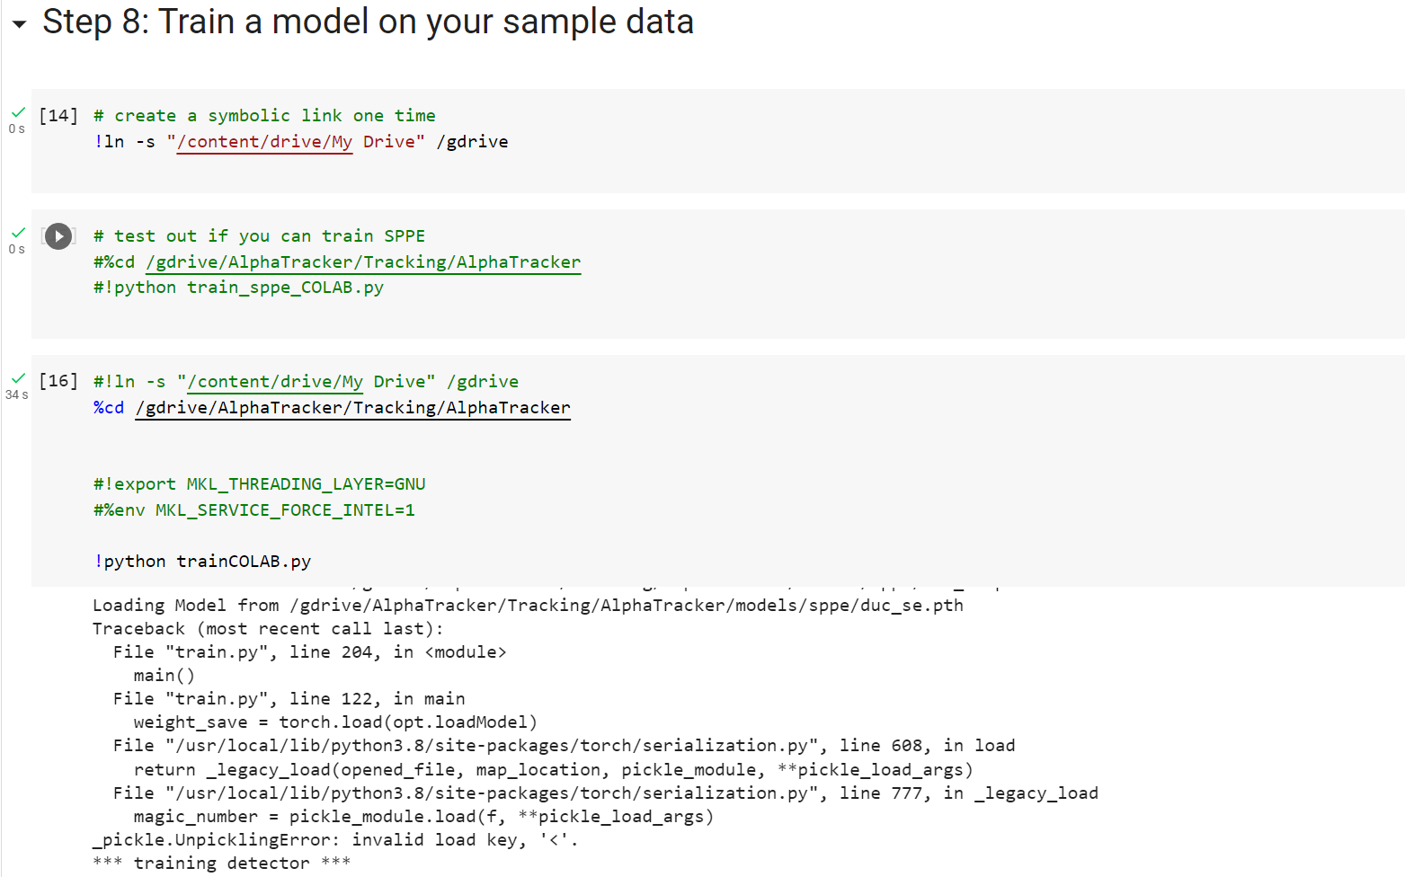
Screenshots of execution

